Slide 1

Relativistic
Velocity

Slide 2
Key objectives
Observations of objects travelling at very high speeds cannot be explained by Newtonian physics. These include the dilated half-life of high-speed muons created in the upper atmosphere, and the momentum of high-speed particles in particle accelerators.
Velocity transformations

Slide 3
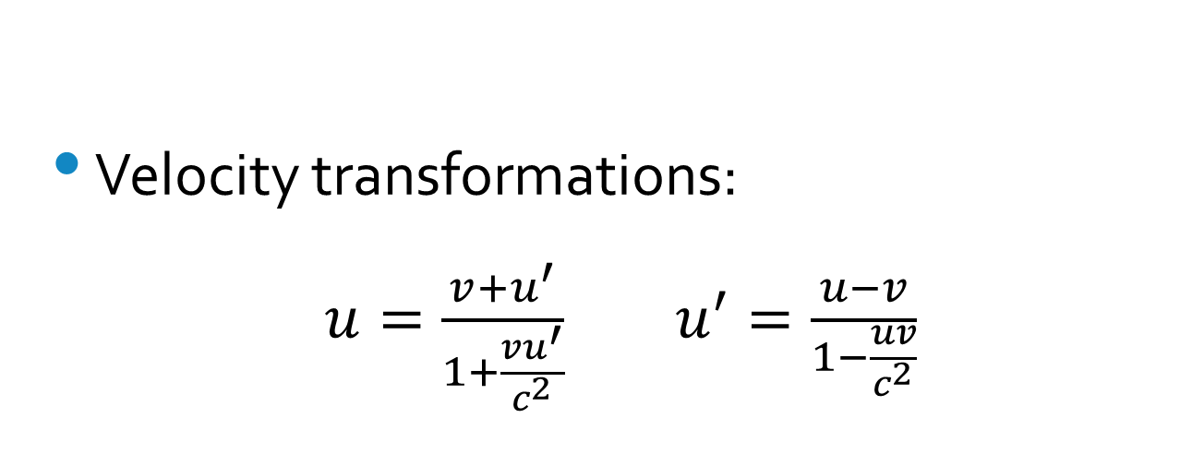
Equations
Velocity transformations:
$u=\frac{v+u^{′}}{1+\frac{vu^{′}}{c^{2}}}$ $u^{′}=\frac{u−v}{1−\frac{uv}{c^{2}}}$

Slide 4
Text References
Step Up 4.4

Slide 5
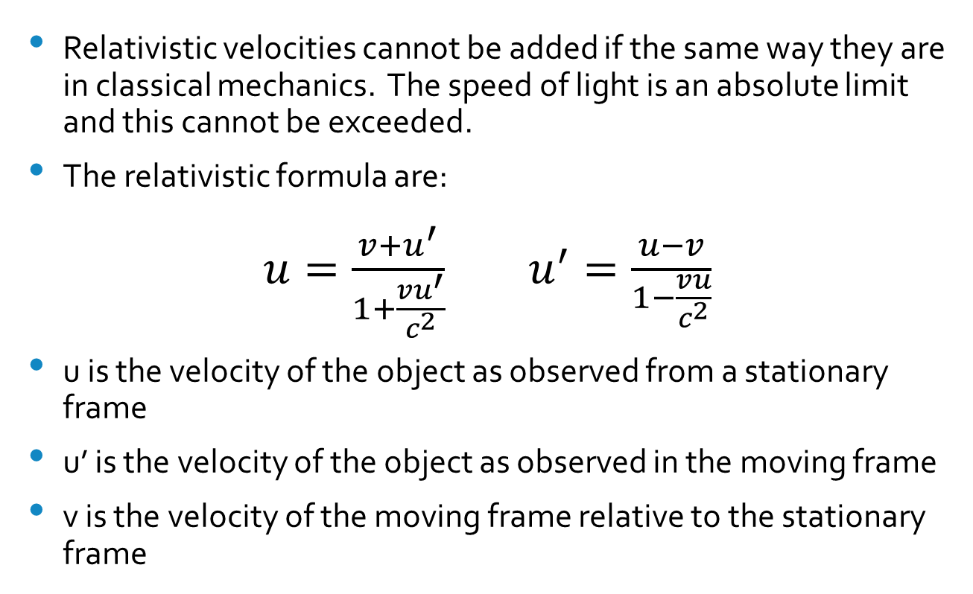
Relativistic addition of velocities
Relativistic velocities cannot be added if the same way they are in classical mechanics. The speed of light is an absolute limit and this cannot be exceeded.
The relativistic formula are:
$u=\frac{v+u^{′}}{1+\frac{vu^{′}}{c^{2}}}$ $u^{′}=\frac{u−v}{1−\frac{vu}{c^{2}}}$
u is the velocity of the object as observed from a stationary frame
u’ is the velocity of the object as observed in the moving frame
v is the velocity of the moving frame relative to the stationary frame

Slide 6


Assigning u, u’ and v
One way to remember which is which is to think of a scenario like this: A person on Earth sees two objects moving at given velocities, v and u. Then that means that the object travelling at v will see the other object as travelling at u’.
u’
v
u

Slide 7
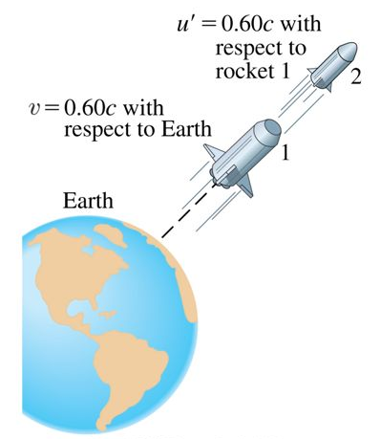
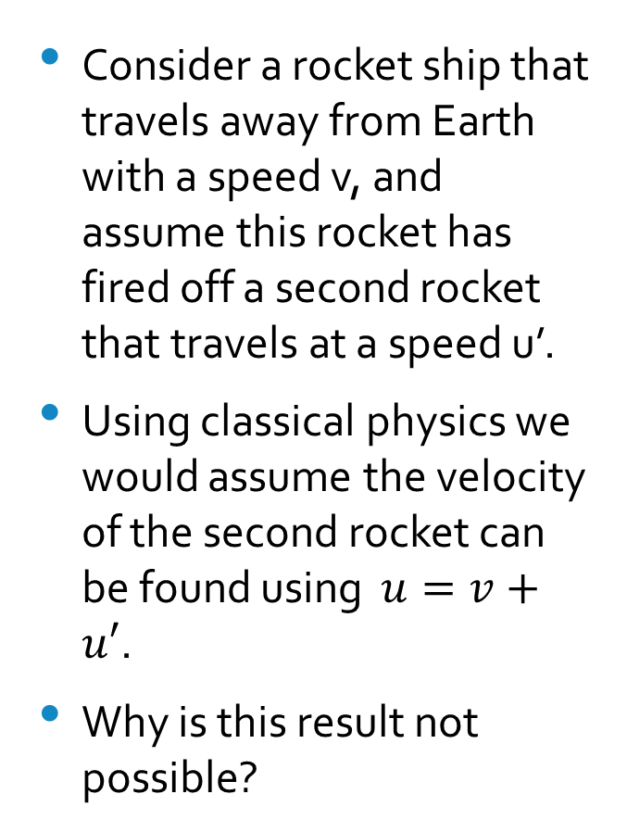
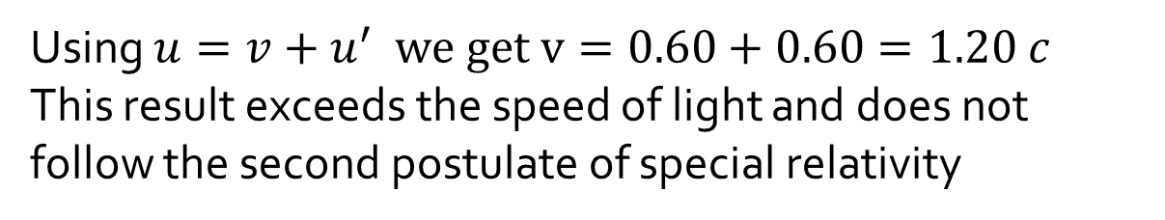
Consider a rocket ship that travels away from Earth with a speed v, and assume this rocket has fired off a second rocket that travels at a speed u’.
Using classical physics we would assume the velocity of the second rocket can be found using $u=v+u′$.
Why is this result not possible?
Using $u=v+u^{′}$ we get $v=0.60+0.60=1.20 c$
This result exceeds the speed of light and does not follow the second postulate of special relativity

Slide 8
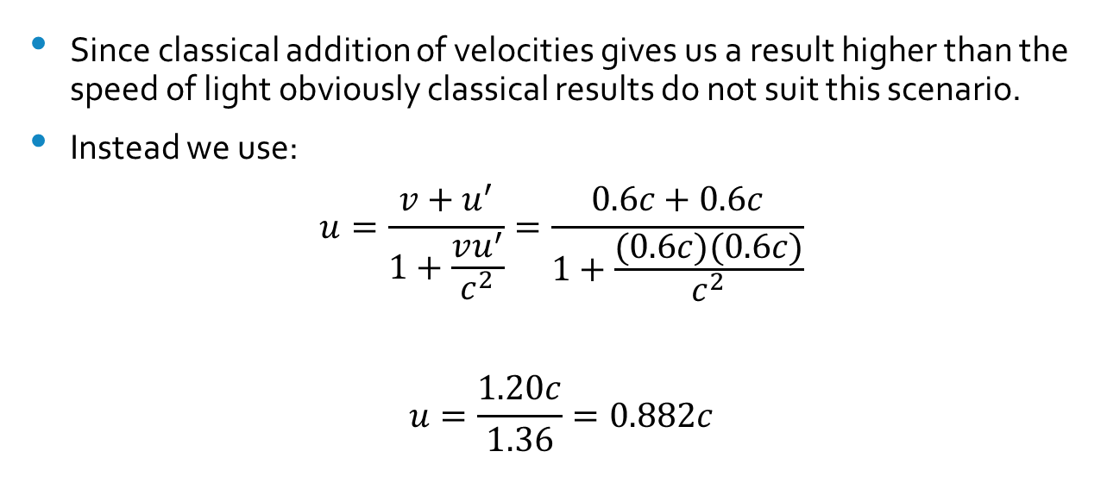
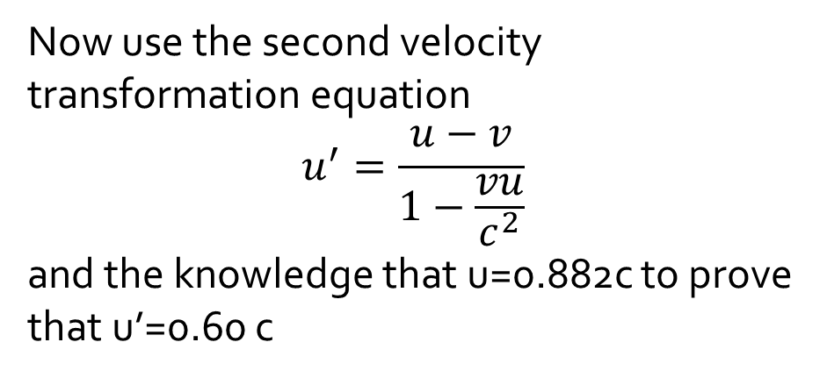
Since classical addition of velocities gives us a result higher than the speed of light obviously classical results do not suit this scenario.
Instead we use:
$$u=\frac{v+u^{′}}{1+\frac{vu^{′}}{c^{2}}}=\frac{0.6c+0.6c}{1+\frac{(0.6c)(0.6c)}{c^{2}}}$$
$$u=\frac{1.20c}{1.36}=0.882c$$
Now use the second velocity transformation equation
$$u^{′}=\frac{u−v}{1−\frac{vu}{c^{2}}}$$
and the knowledge that u=0.882c to prove that u’=0.60 c

Slide 9
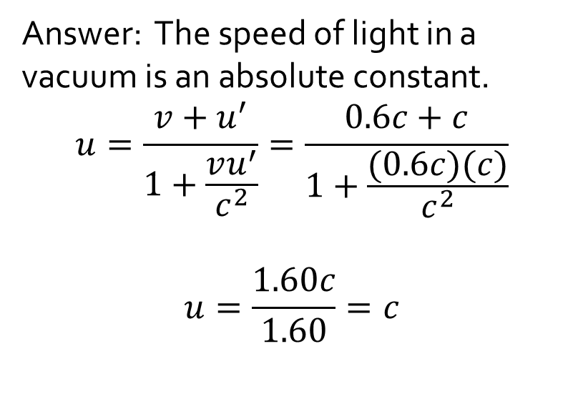
Now lets test our formula in another case: suppose that rocket one sends out a beam of light (so now u’=c).
What do you expect the speed of light to be with reference to an observer on Earth? Support your response by stating the relevant postulate of special relativity and providing relevant calculations
Answer: The speed of light in a vacuum is an absolute constant.
$$u=\frac{v+u^{′}}{1+\frac{vu^{′}}{c^{2}}}=\frac{0.6c+c}{1+\frac{(0.6c)(c)}{c^{2}}}$$
$$u=\frac{1.60c}{1.60}=c$$
u’=c

Slide 10

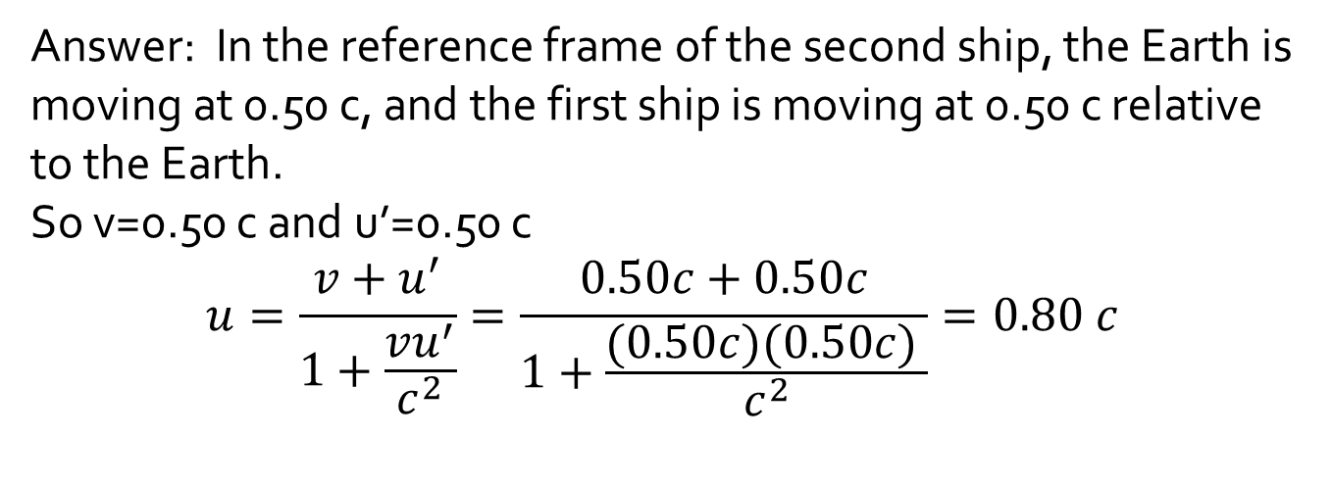
Question: Two spaceships leave Earth in opposite directions, each with a speed of 0.50 c with respect to Earth.
What is the velocity of spaceship 1 relative to spaceship 2?
Answer: In the reference frame of the second ship, the Earth is moving at 0.50 c, and the first ship is moving at 0.50 c relative to the Earth.
So v=0.50 c and u’=0.50 c
$$u=\frac{v+u^{′}}{1+\frac{vu^{′}}{c^{2}}}=\frac{0.50c+0.50c}{1+\frac{(0.50c)(0.50c) }{c^{2}}}=0.80 c$$

Slide 11
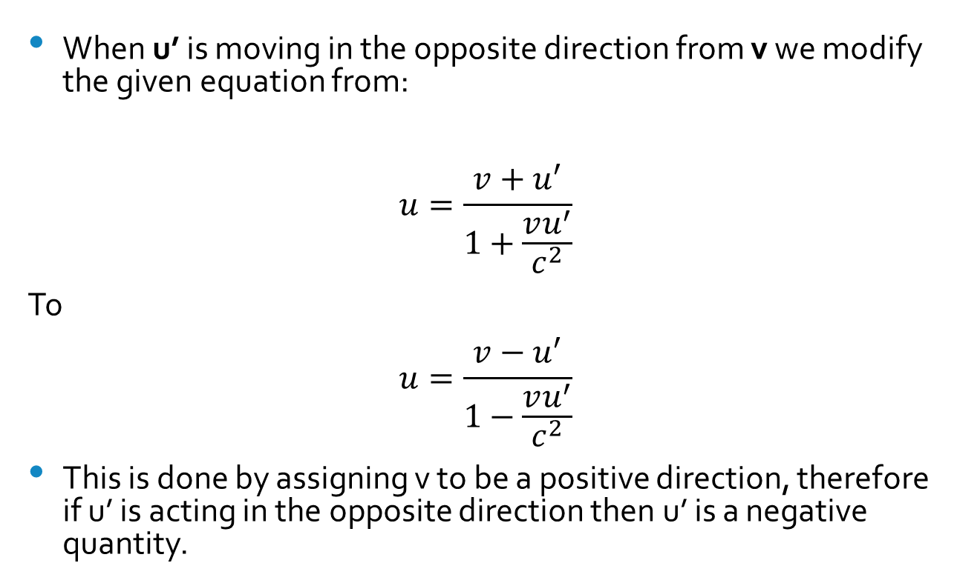
Opposite directions…
When u’ is moving in the opposite direction from v we modify the given equation from:
$$u=\frac{v+u^{′}}{1+\frac{vu^{′}}{c^{2}}}$$
To
$$u=\frac{v−u^{′}}{1−\frac{vu^{′}}{c^{2}}}$$
This is done by assigning v to be a positive direction, therefore if u’ is acting in the opposite direction then u’ is a negative quantity.

Slide 12
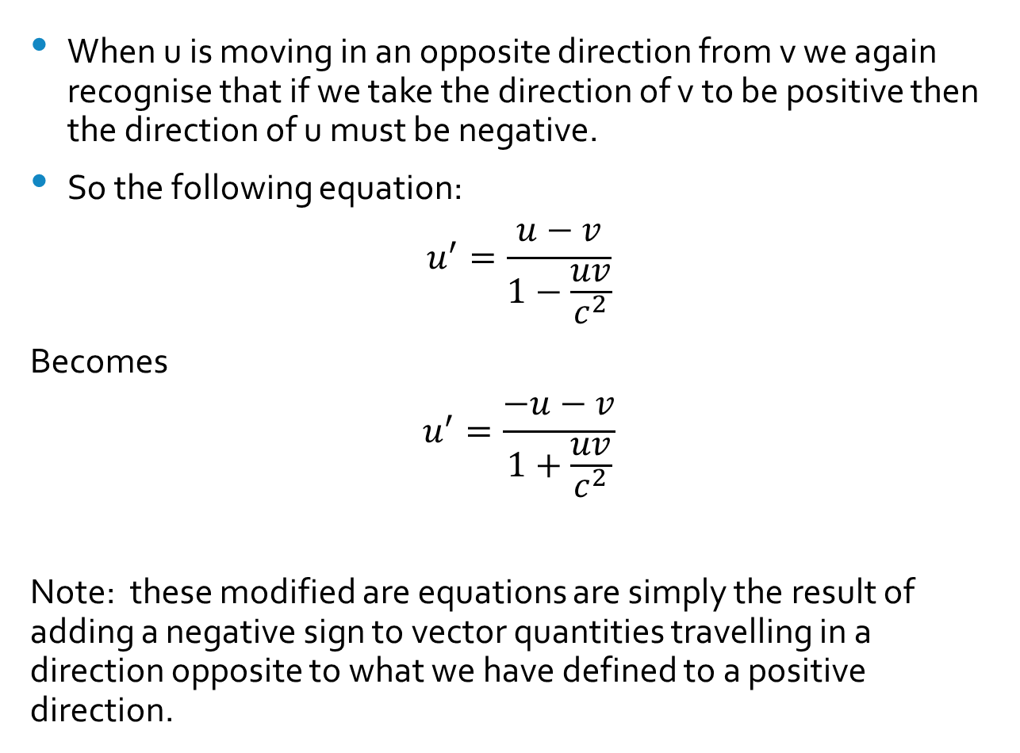
When u is moving in an opposite direction from v we again recognise that if we take the direction of v to be positive then the direction of u must be negative.
So the following equation:
$$u^{′}=\frac{u−v}{1−\frac{uv}{c^{2}}}$$
Becomes
$$u^{′}=\frac{−u−v}{1+\frac{uv}{c^{2}}}$$
Note: these modified are equations are simply the result of adding a negative sign to vector quantities travelling in a direction opposite to what we have defined to a positive direction.

Slide 13

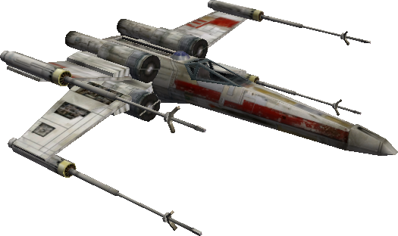
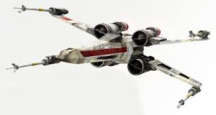
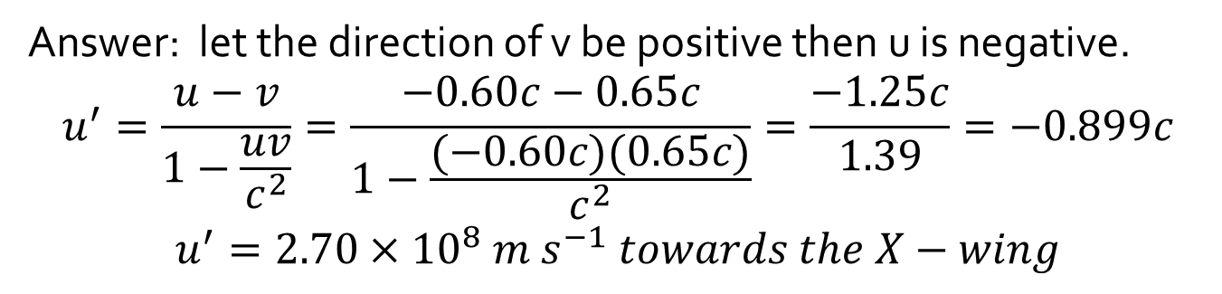
Question: An X-wing and a starfighter are flying towards each other the X-wing has a velocity of 0.650 c and the starfighter of 0.600C as measured in Earths reference frame.
Calculate the velocity (in m/s) of the starfighter as measured by the crew of the X-wing
v=0.650 c
u=0.600 c
X-wing
Starfighter
Answer: let the direction of v be positive then u is negative.
$$u^{′}=\frac{u−v}{1−\frac{uv}{c^{2}}}=\frac{−0.60c−0.65c}{1−\frac{(−0.60c)(0.65c)}{c^{2}}}=\frac{−1.25c}{1.39}=−0.899c$$
$$u^{′}=2.70×{10}^{8} m s^{−1} towards the X−wing$$

Slide 14
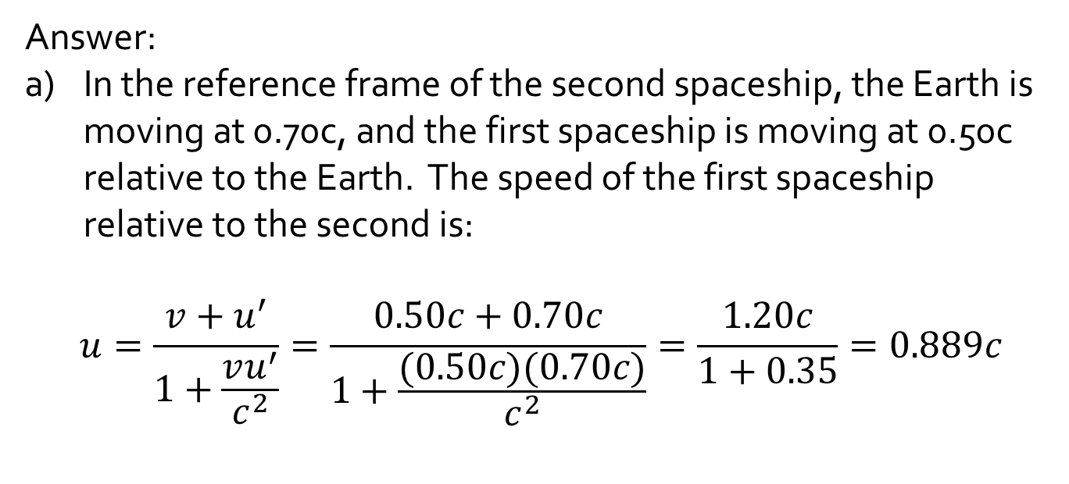
Question: Two spaceships leave Earth in opposite directions, spaceship 1 with a speed of 0.50 c and spaceship 2 with a speed of 0.70 c with respect to Earth.
What is the velocity of spaceship 1 relative to spaceship 2?
What is the velocity of spaceship 2 relative to spaceship 1?
Answer:
In the reference frame of the second spaceship, the Earth is moving at 0.70c, and the first spaceship is moving at 0.50c relative to the Earth. The speed of the first spaceship relative to the second is:
$$u=\frac{v+u^{′}}{1+\frac{vu^{′}}{c^{2}}}=\frac{0.50c+0.70c}{1+\frac{(0.50c)(0.70c)}{c^{2}}}=\frac{1.20c}{1+0.35}=0.889c$$

Slide 15
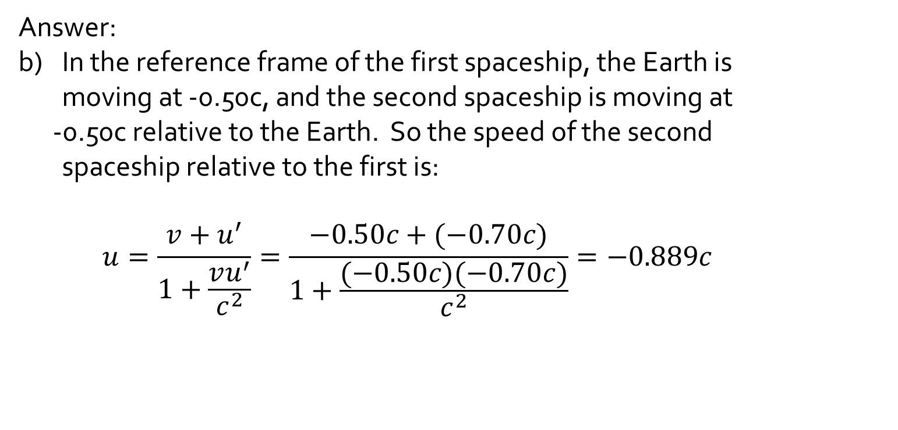
Question: Two spaceships leave Earth in opposite directions, each with a speed of 0.50 c with respect to Earth.
What is the velocity of spaceship 1 relative to spaceship 2?
What is the velocity of spaceship 2 relative to spaceship 1?
Answer:
In the reference frame of the first spaceship, the Earth is moving at -0.50c, and the second spaceship is moving at
-0.50c relative to the Earth. So the speed of the second spaceship relative to the first is:
$$u=\frac{v+u^{′}}{1+\frac{vu^{′}}{c^{2}}}=\frac{−0.50c+(−0.70c)}{1+\frac{(−0.50c)(−0.70c)}{c^{2}}}=−0.889c$$

